Slide 1
Istanbul Sehir University
College of Engineering and Natural Sciences
ENGR 105 Introduction to Engineering
Lecture
Information Research
Technical Writing
Prof. Dr. Ömer Cebeci

Slide 2
DESIRED QUALIFICATIONS
1. Good communication, computer and teamwork skills
2. Good scientific background, and ability to test & verify facts & ideas
3. Design capability
4. Proper professional & ethical attitudes

Slide 3
DESIRED QUALIFICATIONS I
Good communication,
computer and teamwork skills
(including open-mind,
positive attitude and
leadership skills)

Slide 4
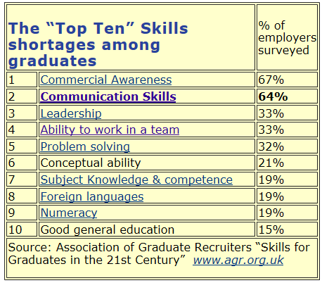
http://www.kent.ac.uk/careers/presentationskills.htm

Slide 5
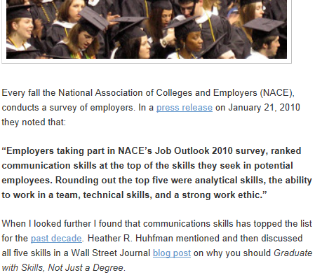
http://joyfulpublicspeaking.blogspot.com.tr/2010_12_01_archive.html

Slide 6

https://www.slideshare.net/jessedee/you-suck-at-powerpoint/9-5SHOCKING_DESIGN_MISTAKESYOU_NEEDTO_AVOID

Slide 7
You will communicate not only with fellow engineers, but with many colleagues with diverse backgrounds and functions
in the organization and outside,
with clients and customers,
with government authorities, officers, lawyers, managers, directors, and many others.

Slide 8
You will have to communicate a lot in professional life
as you progress in your career, you will be spending more time communicating,
than
making calculations, solving equations or writing codes

Slide 9
If you can communicate well,
you will understand well and
you will be understood well;
you will have an advantage
You will be able to get what you need more quickly, your contributions to the organization will be obvious,
and you will be rewarded accordingly

Slide 10
Writing and reading, and
talking and listening are
the basic methods
of communication
In business environment you will also be
engaged in casual conversation,
group work and discussions,
interviews, meetings,
delivering speeches & presentations,
attending seminars and conferences

Slide 11
Effective communicators use
both verbal and nonverbal signals
to get their messages across
Moreover, they pay as much attention to receiving information as they do
to transmitting it

Slide 12
In this part of the course,
we will discuss technical writing
From a well written document you can prepare a good executive summary or an oral presentation or other communications
Information research, or gathering technical information is an essential preliminary process in organizing and writing an effective communication

Slide 13
The following are the common types of technical documents:
Reports – Lab, Project, Research, Feasibility, Investigation, Evaluation
Abstract, Summary
Term paper, Thesis, Dissertation, Article, Review Paper
Instructions, Procedures, Manuals
CV, Resume, Application Letters
Memo/Notes
Discussions

Slide 14
Technical writing is the communication of specific technical information to an identified reader, so that the reader’s understanding matches the writer’s intention

Slide 15
The writer’s responsibility is
to make the communication:
Accurate - supported & verified
Clear - having only one meaning for the reader
Complete & concise - economical & direct
Well-organized & correct – easy to follow and free from errors in form, grammar, usage, punctuation & spelling

Slide 16
Before starting to write your draft
you must go through a number of steps
Planning
Gathering & Organizing Information
Reviewing the Organization

Slide 17
Planning for Writing
Determine your purpose for writing
Focus on your reader
Limit the scope of the topic
Decide the proper form, style & tone

Slide 18
Planning for Writing
Determine your purpose for writing
To explain / define what something is or means
To describe an object or a process
To instruct (tell how to do something)
To analyze as a basis for a conclusion
To report status or progress
To interpret, evaluate, judge or recommend
To propose, sell or persuade

Slide 19
Planning for Writing
Focus on your reader
Readers can be classified
according to their FUNCTION (what they do) as
Generalist - Manager - Operator - Technician - Specialist
and
according to their BACKGROUND (what they know) as
Least Technical (Generalist) ---- Most Technical (Specialist)

Slide 20
Planning for Writing
Focus on your reader
When you write to a Generalist:
Free from jargon
Easy to understand
Clear organization, examples, comparisons
Avoiding equations & formulae
When writing to a Specialist
Use shared technical vocabulary
Follow scientific methods in work & writing
Provide theory, equations, data
Refer to additional studies & sources

Slide 21
Planning for Writing
Limit the scope of the topic
Decide about the length of the writing depending on
how much time you want to spend for writing &
more important, how much time your reader wants to spend for reading
and what will be the useful life of the document

Slide 22
Planning for Writing
Determine the form, style & tone
Content is what you say/write
Form/style/tone is how you say it
Tone may be
positive, neutral , negative
writer centered, reader centered

Slide 23
Gathering & Organizing Information
(Information Research)
Information can be gathered
From Recorded Sources
By Contacting Knowledgeable People
By Personal Investigation

Slide 24
Recorded Sources of Information
Books
Reference materials (Dictionary, Encyclopedia, Handbook)
Periodicals, indexes, abstracts
Conference & symposium proceedings and abstracts
Government documents and reports (TUİK, YÖK, etc)
Organization documents and reports (TOBB, UNESCO)
Company/commercial documents and reports
Private writings

Slide 25
Contacting Knowledgeable People
For unwritten - unpublished information and opinions you may contact specialist, technicians, managers etc by
letters, interview, surveys

Slide 26
Personal Investigation
Lab/trip/site reports, progress/status reports etc
May be one of three activities
Observation
Examination
Experimentation

Slide 27
Organizing Information
Re-consider your purpose-reader-scope-tone and
re-adjust if necessary
according to the information you found
Then review the information you collected
evaluating & sorting according to what is:
VALID - RELEVANT - USEFUL INFORMATION (correct & reliable)
This process will also show you what is missing and where your information is thin and unreliable!

Slide 28
Organizing Information
DECIDE on the MAJOR POINT(S)
you want to make and
CHOOSE the SUBPOINTS
that support your major point .
Remember: capacity of short term memory = 7(+ or -)2 points!

Slide 29
Organizing Information
Theorists tell us that information can be handled / itemized
in three different ways
RANDOMLY
SEQUANTIALY - equally important items
HIERARCHICALLY – different
value - rank - level

Slide 30
Organizing Information
SEQUANTIALY - equally important items
1. Chronological : Points are arranged from first to last on the basis of time
2. Spatial : Points are arranged as they appear physically top to bottom, left to right, outside to inside, etc.

Slide 31
Organizing Information
HIERARCHICIALLY
1. Comparison or Contrast : Points are chosen to show similarities or differences between elements
2. Pro and Con : Points are determined to be either advantages or disadvantages
3. Division or Classification : Points are determined by breaking a topic into its most important parts or functions or by grouping related items

Slide 32
Organizing Information
COMBINED METHODS
1. Problem - Cause - Solution
2. Cause and Effect (or Effect and Cause): Hierarchically choose the more important, cause or effect, and then present the supporting points sequentially

Slide 33
Organizing Information
COMBINED METHODS
3. Decreasing (or Increasing) Order of Importance: Decreasing gets the readers’ attention but increasing works well with a potentially hostile reader.
4. General to Specific (also called Simple to Complex or Deductive) or Specific to General (also called Complex to Simple or Inductive)

Slide 34
Before starting to write your draft
you must go through a number of steps
Planning
Gathering & Organizing Information
Reviewing the Organization

Slide 35
Reviewing the Organization
You haven’t written the text yet
but you have decided what to write
Then you are ready to review
what you are going to write
Self Review
Peer Review
Manager/Instructor Review

Slide 36
Since you have gone through your
Planning
Gathering & Organizing Information
Reviewing the Organization
You are now ready to write you draft

Slide 37
While writing, REVEAL THE ORGANIZATION to your readers
Compose a meaningful title or reference line
Tell the reader/audience what to expect and stick to the point
Develop coherent paragraphs and make subpoints grammatically parallel
(Topic sentence = main point
related sentences = sub points)

Slide 38
While writing REVEAL THE ORGANIZATION to your readers
Write good transitions between paragraphs, sections,...
Connect new information to existing ideas
Provide overviews, emphasize and review key points (Table of contents, abstract, index)
Clarify the organization with visual markers – bold, underline italic, CAPITALS, etc

Slide 39
To finalize your work REVIEW & REVISE it
CONTENT REVIEW
Check for technical accuracy and logic
Check appropriateness of the
purpose-reader-scope-tone-style
ORGANIZATION REVIEW
Check for clarity of presentation

Slide 40
To finalize your work REVIEW & REVISE it
EDITORIAL REVIEW
Check for correctness of
grammar
diction-word choice, using clear words
syntax-word order, constructing effective sentences
spelling
punctuation
This review should be done by yourself, your peer, and your manager/instructor as well

Slide 41
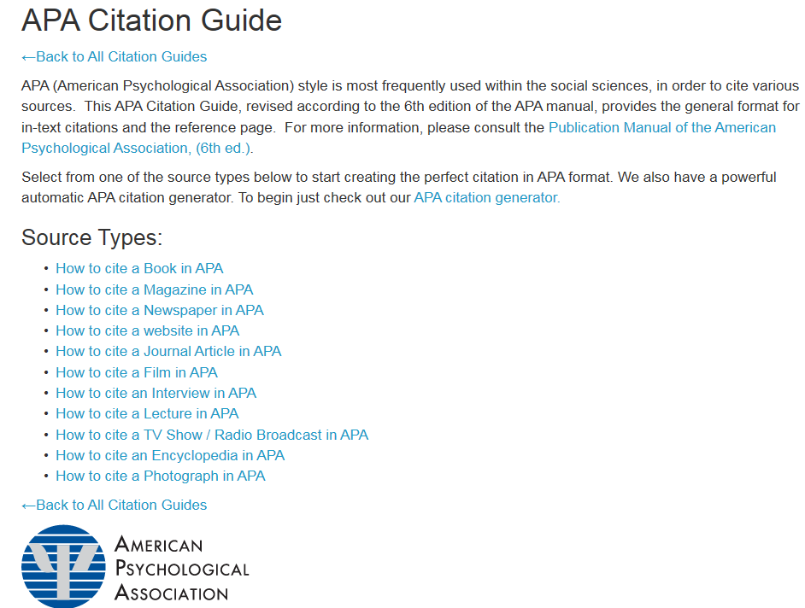

Slide 42
Citing a general website article with an author
APA format structure:
Author, A.A.. (Year, Month Date of Publication). Article title. Retrieved from URL
APA format example:
Simmons, B. (2015, January 9). The tale of two Flaccos. Retrieved from http://grantland.com/the-triangle/the-tale-of-two-flaccos/
http://www.bibme.org/citation-guide/apa/website/

Slide 43

Citing a general website article without an author
APA format structure:
Article title. (Year, Month Date of Publication). Retrieved from URL
APA format example:
Teen posed as doctor at West Palm Beach hospital: police. (2015, January 16). Retrieved from http://www.nbcmiami.com/news/local/Teen-Posed-as-Doctor-at-West-Palm-Beach-Hospital-Police-288810831.html
http://www.bibme.org/citation-guide/apa/website/

